Slide 1
Capstone Project
About
Learning Objectives
Office Work
Field Work
Thank you
ç
Mian Wang
Supervisor: Lale Eristurk
Unit: Water Quality

Slide 2
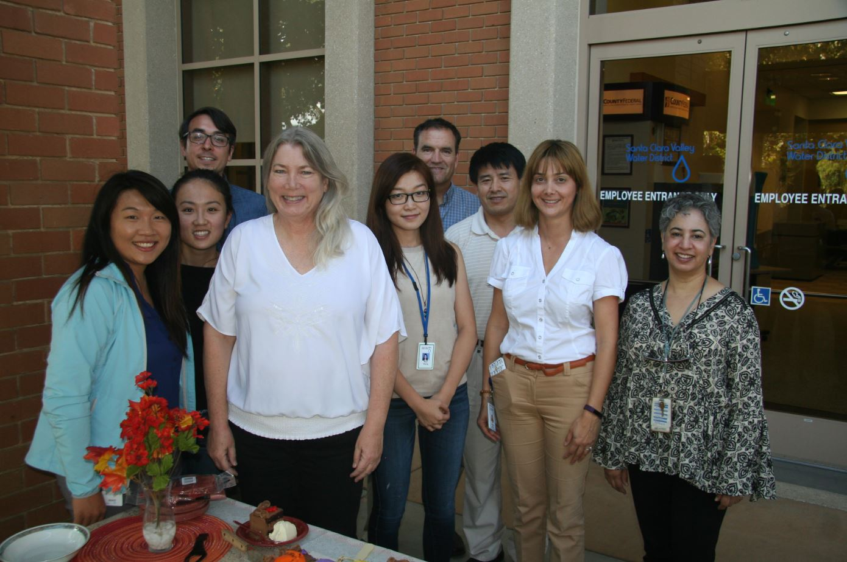
About

Slide 3

Learning objectives
about
Learning objectives
Field work
Office work
Thank you
Academic Learning and Application /Skill Development
Professional Development
Gain an understanding of process engineering and operations of District’s water treatment plants and recycled water facility, and hands-on experience in working with water quality liaisons and plant operations staff.
1.
Analyze and evaluate historical operational and water qulaity data for the water treatment plants by using Operations Data Management System (ODMS) and Laboratory Information Management System (LIMS) and Laboratory Information Management System (LIMS).
2.
3.
Operate and maintain pilot-scale Reverse Osmosis (RO) system for the SVAWPC RO pretreatment chemical optimization.
4.
Develop networking skills such as communication, collaboration and social asset building.

Slide 4
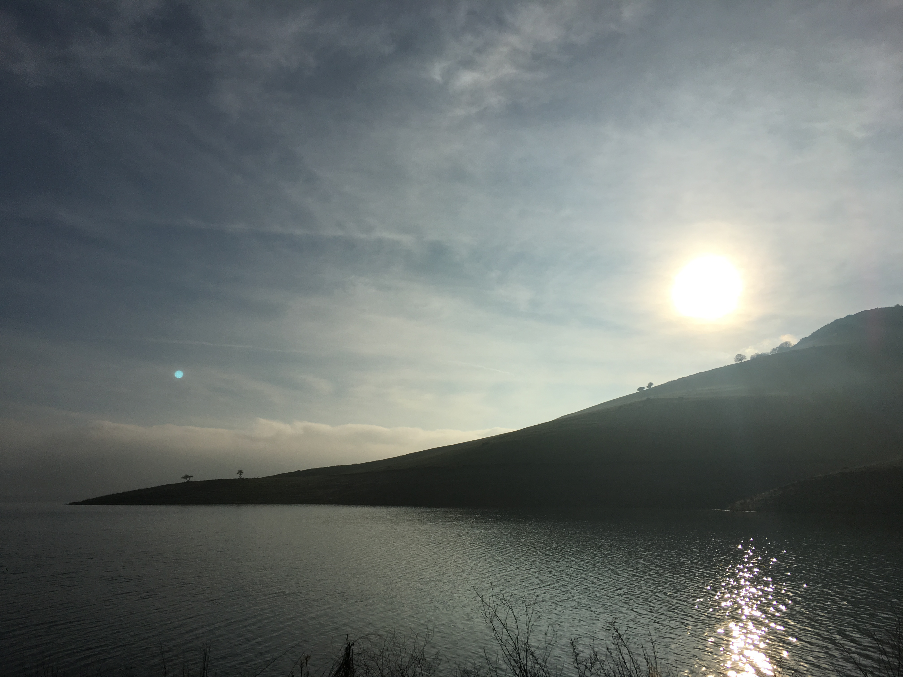
Field Work

Slide 5
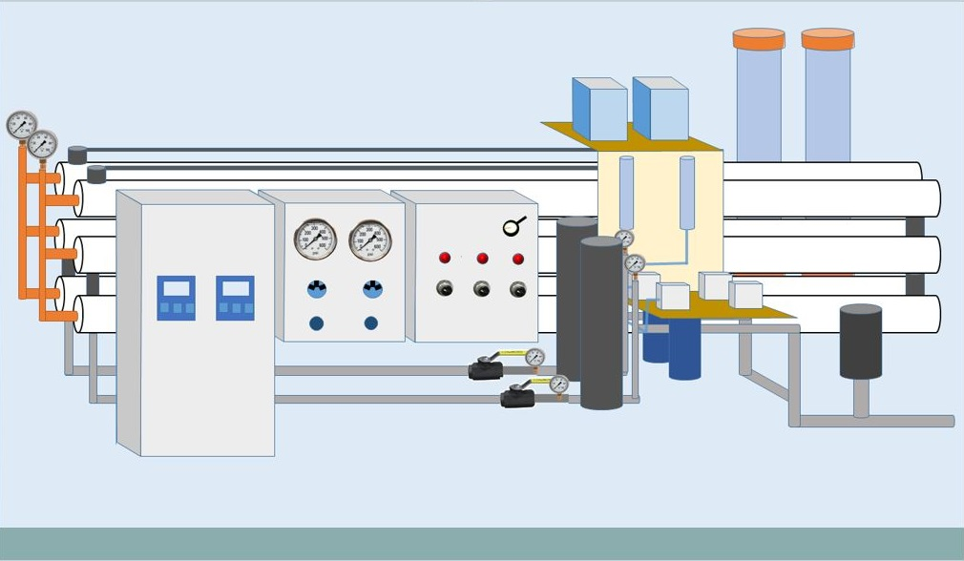
Reverse osmosis pilot study
About
Learning objectives
Field work
Office work
Thank you
Learning Objective 2

Slide 6
about
Learning objectives
Field work
Office work
Thank you
Reverse osmosis pilot study
Antiscalant Study
High feedwater pH
High recovery rates
Membrane elements from different manufacters

Slide 7
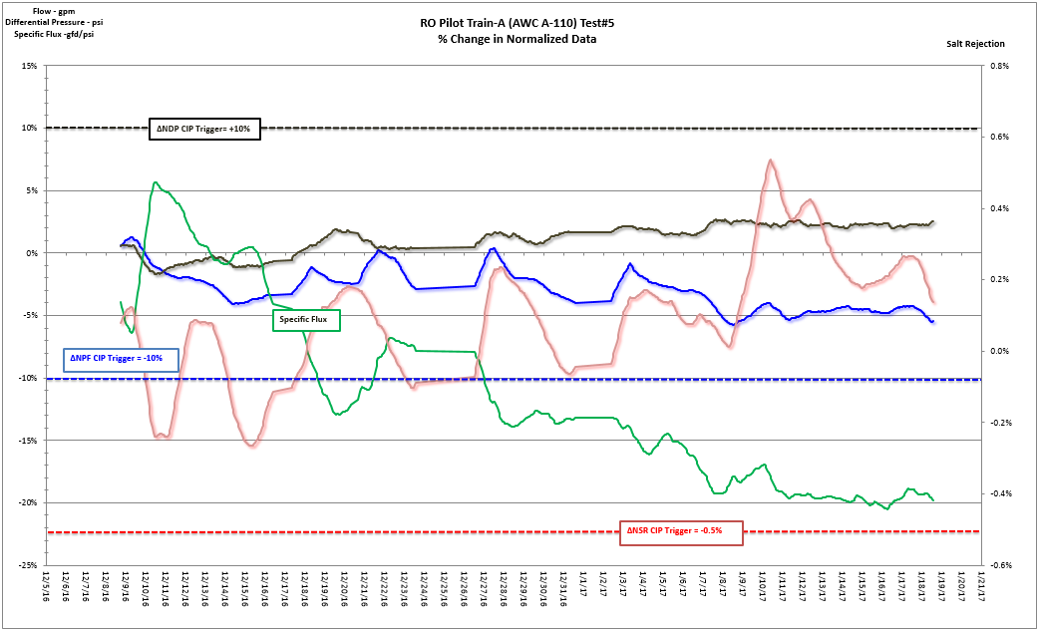
about
Learning objectives
Field work
Office work
Thank you
Reverse osmosis pilot study

Slide 8
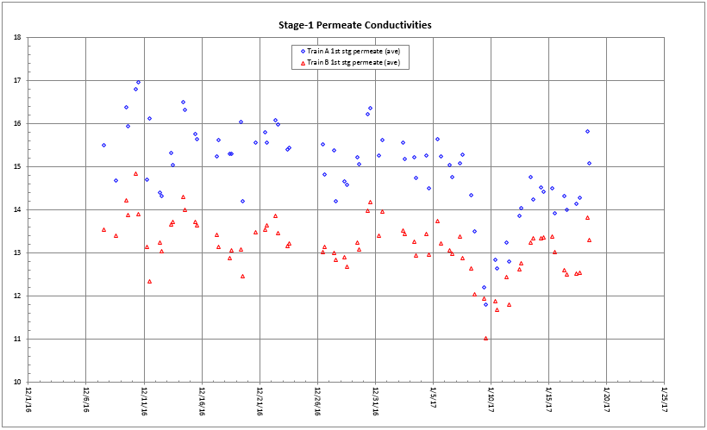
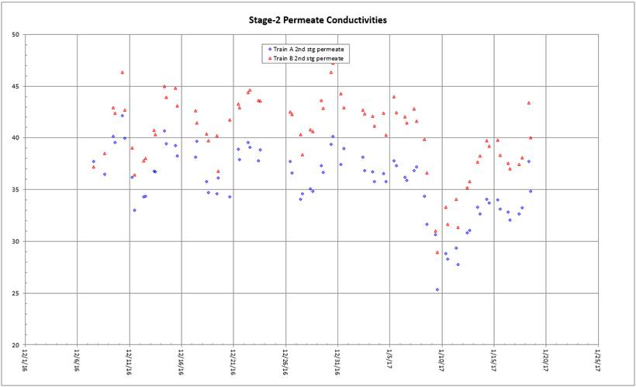
RO pilot data normalization
company name
about
Learning objectives
Filed work
Office work
Thank you
 | Train A | Train B | Better performance?
Δ Specific flux | -20% | -15% | Train B
ΔNSR | 0.15% | 0.1% (grab) | Train A
ΔNPF | -5% | 1% | Train B
ΔNDP | 2.5% | 1% | Train B

Slide 9
RO Pilot Study
company name
about
Learning objectives
Filed work
Office work
Thank you
01
Operate and maintain the pilot; CIP
02
Data normalization
03
Safety inspection
04
Waste inventory
Title Text

Slide 10
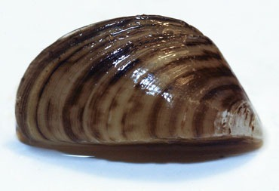
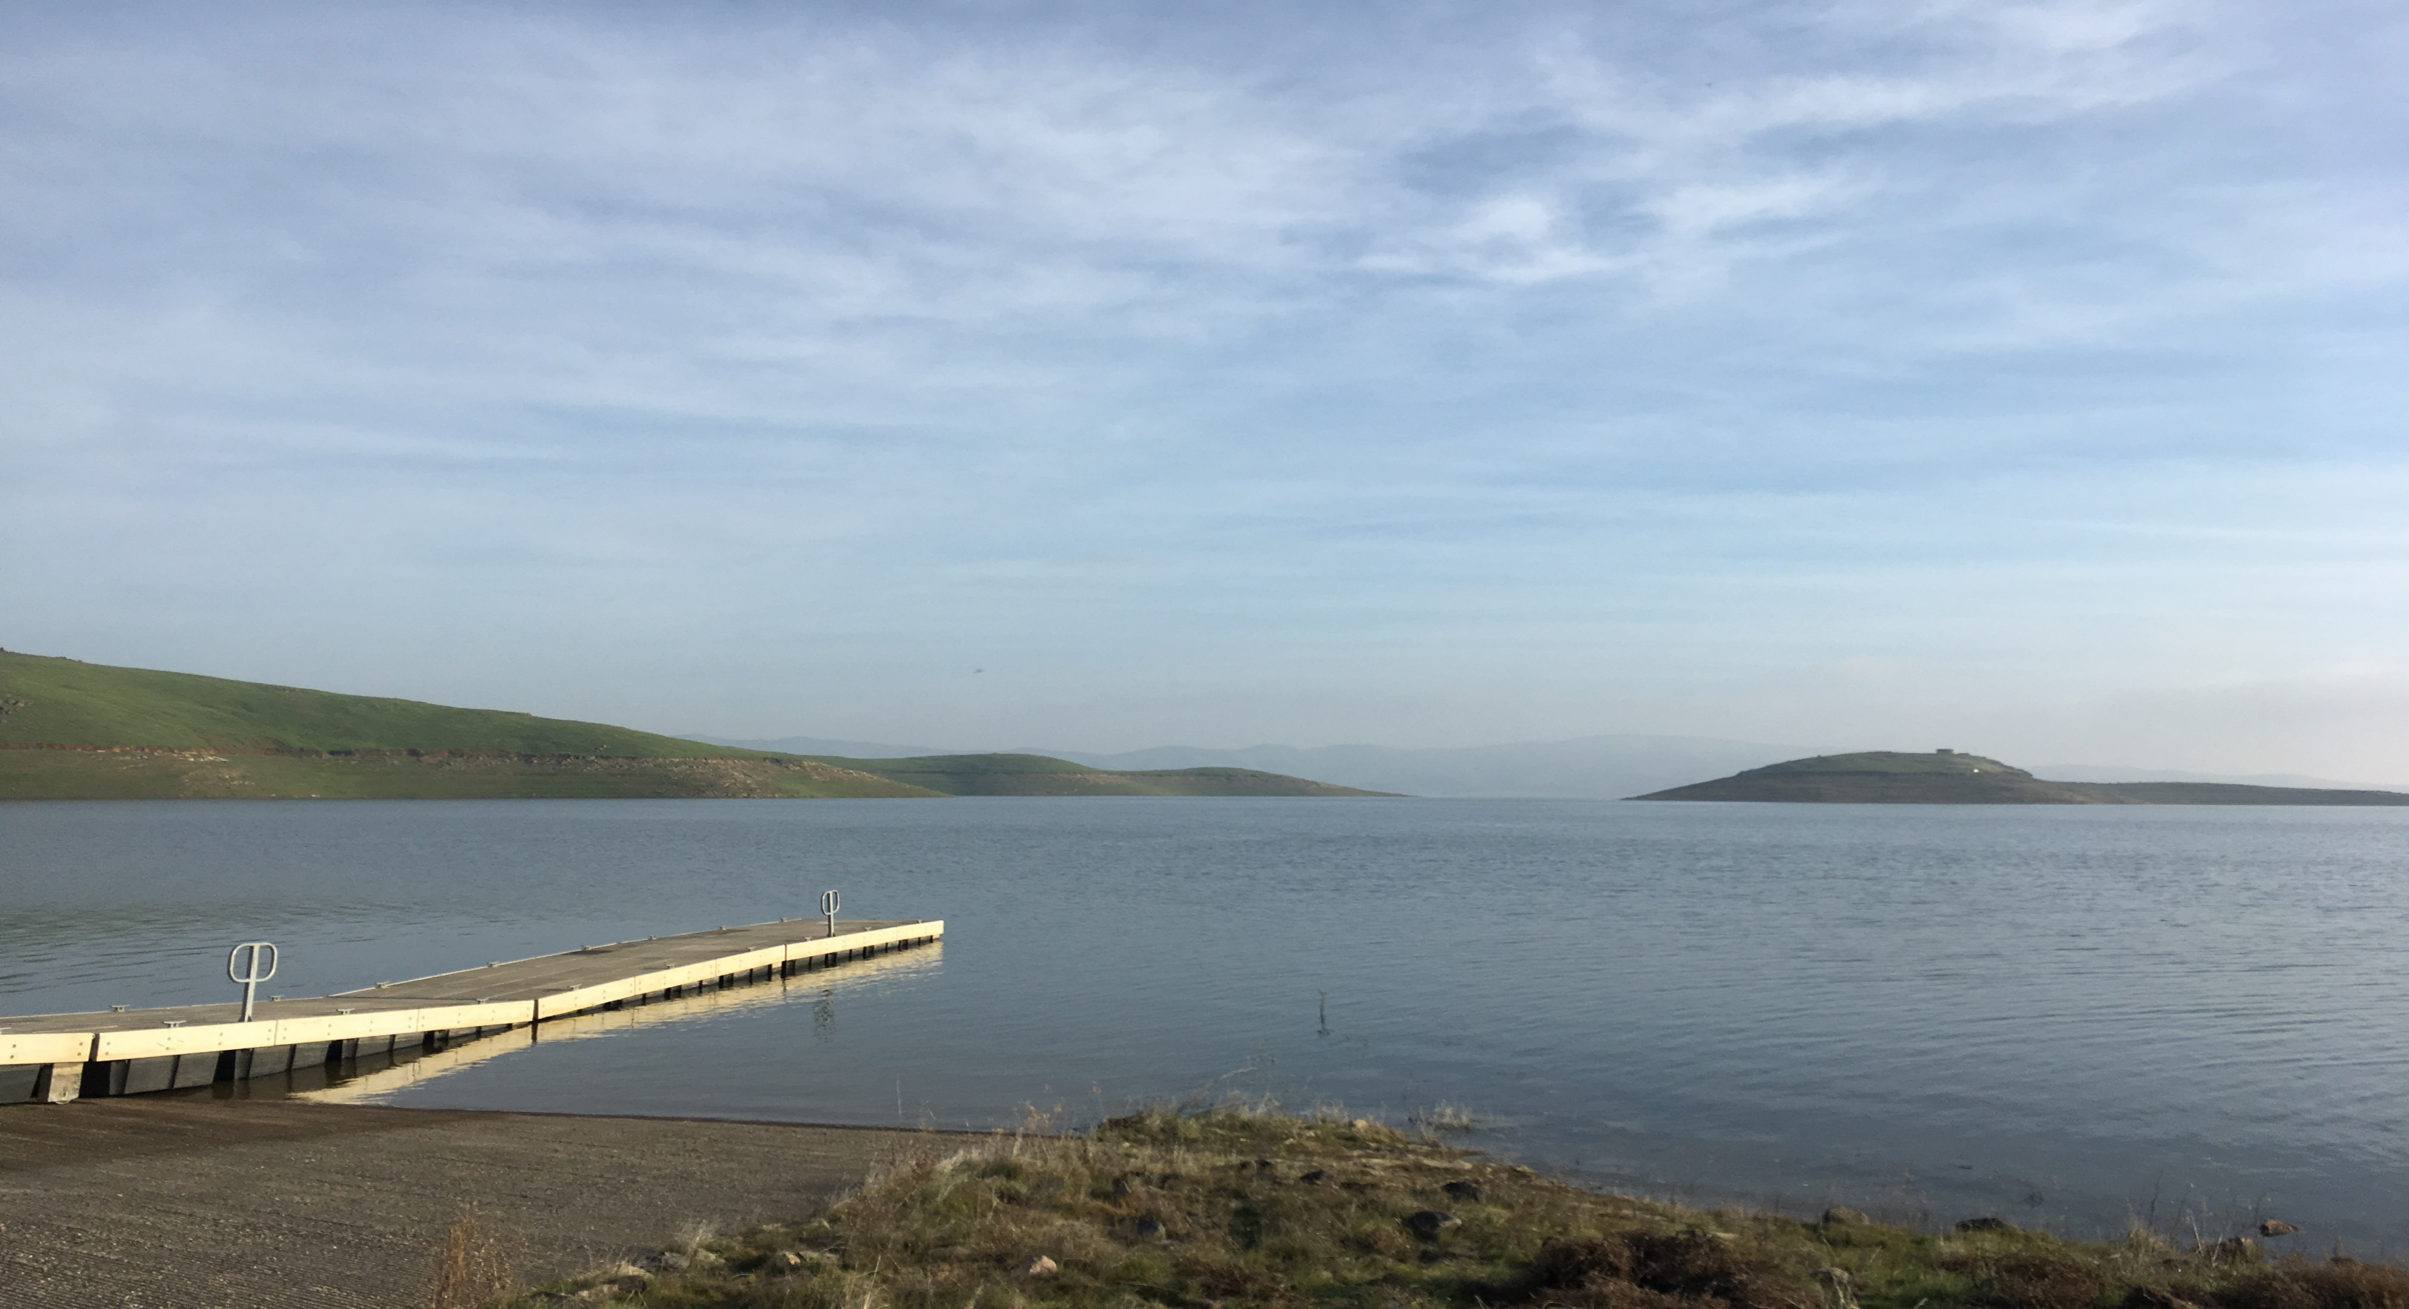
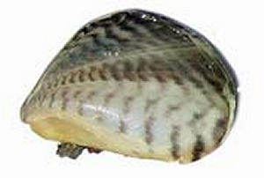
Invasive Mussel monitoring
company name
about
Learning objectives
Field work
Office work
Thank you
Zebra Mussel
Quagga Mussel

Slide 11
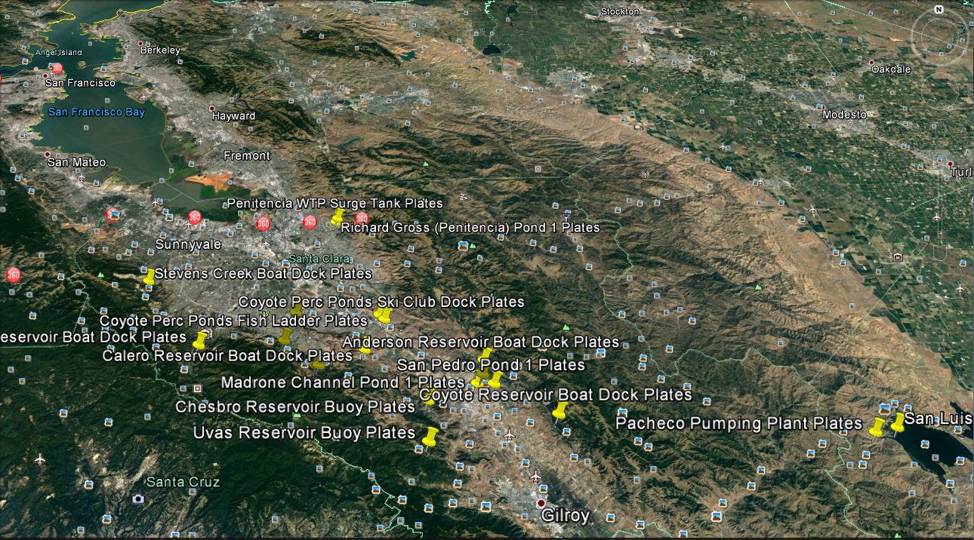
About
Learning objectives
Field work
Office work
Thank you

Slide 12
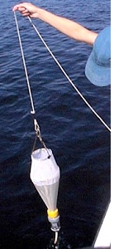
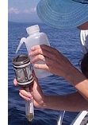
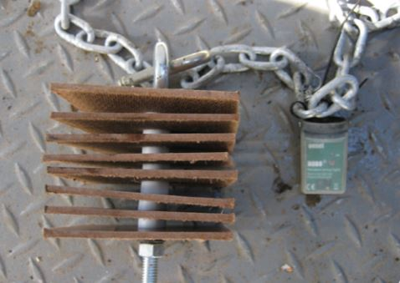
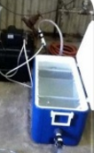
Invasive Mussel monitoring
about
Learning objectives
Filed work
Office work
Thank you
Plankton net
Artificial substrates
Biobox
collect veliger
provide habitat for invasive mussles
Same as artificial substrates

Slide 13
company name
about
Learning objectives
Field work
Office work
Thank you
Other projects:
Pipeline disinfection
PWTP filter inspection

Slide 14
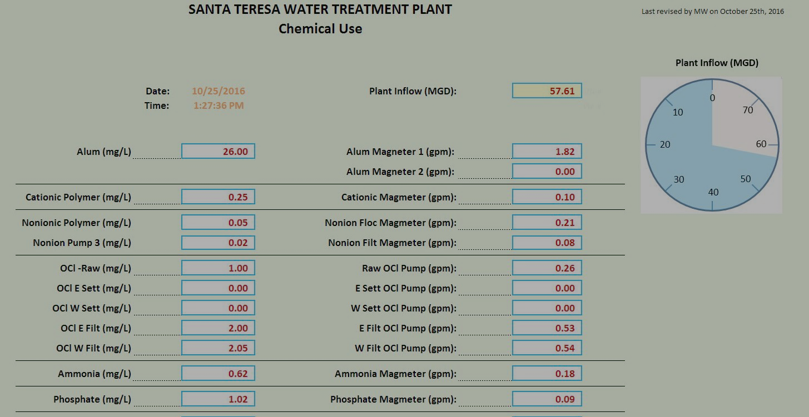
Office Work

Slide 15
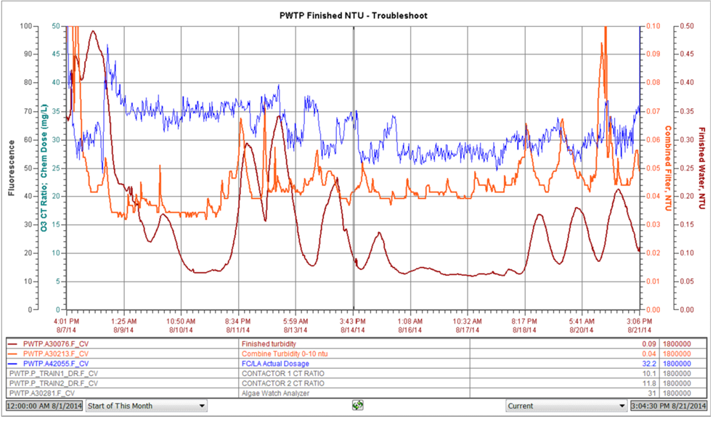
About
Learning objectives
Field work
Office work
Thank you
PWTP finished water turbidity spikes

Slide 16
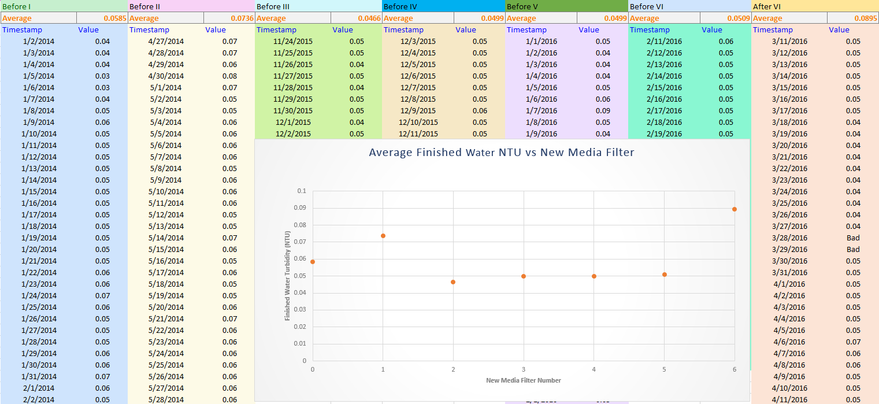
About
Learning objectives
Field work
Office work
Thank you
PWTP finished water turbidity spikes

Slide 17
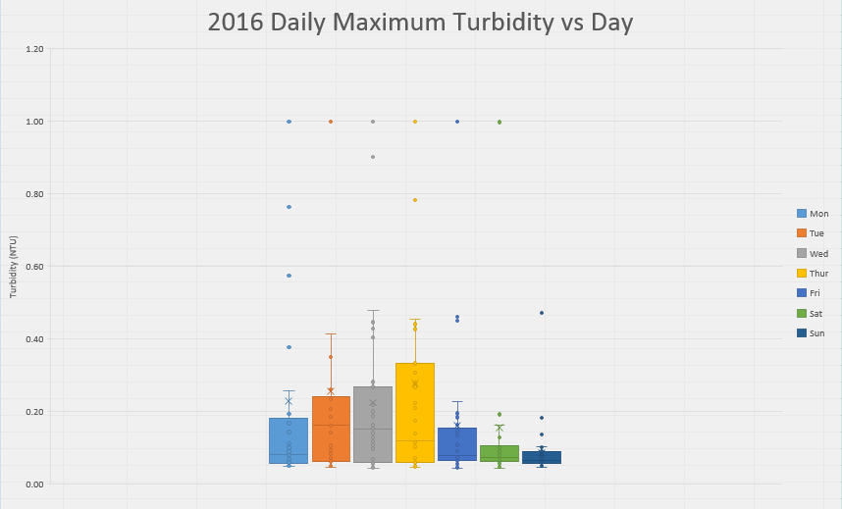
About
Learning objectives
Field work
Office work
Thank you
PWTP finished water turbidity spikes

Slide 18
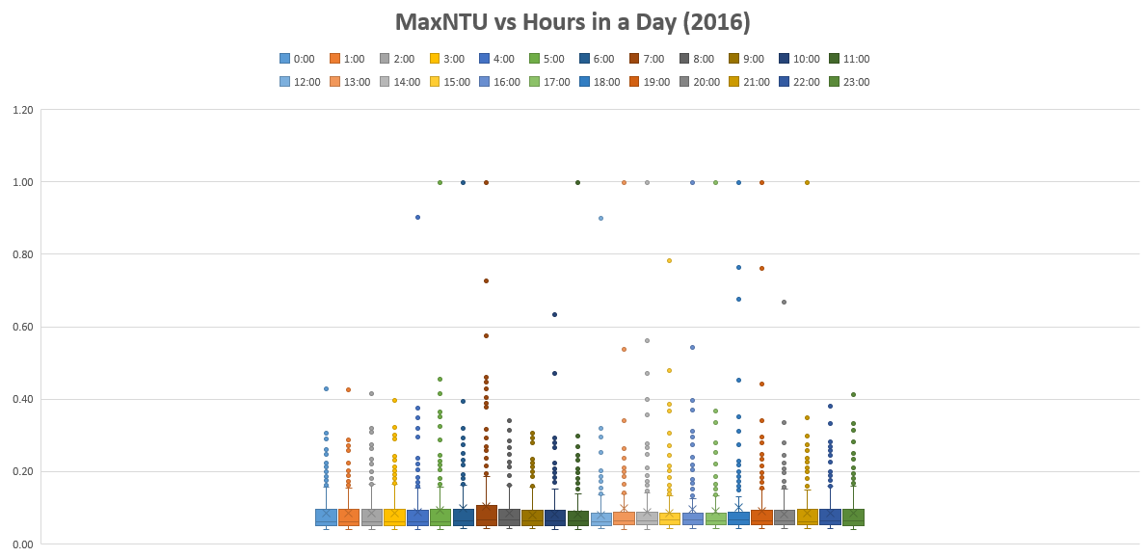
About
Learning objectives
Field work
Office work
Thank you
PWTP finished water turbidity spikes

Slide 19
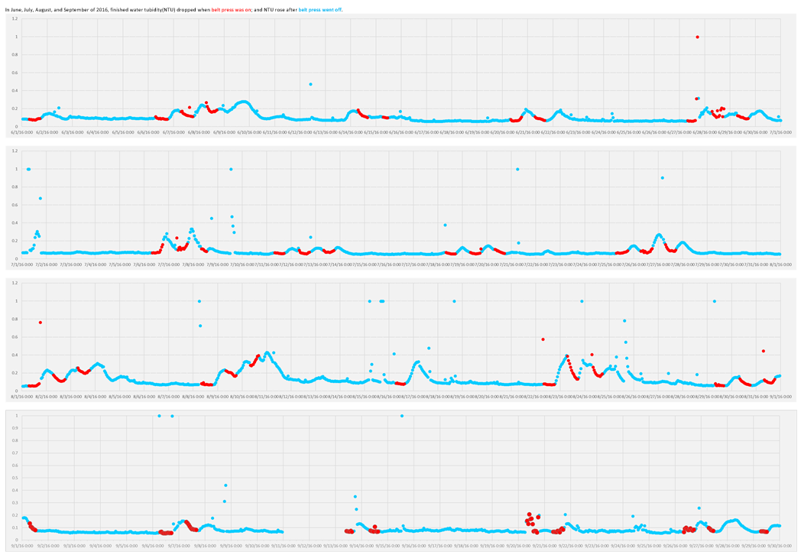
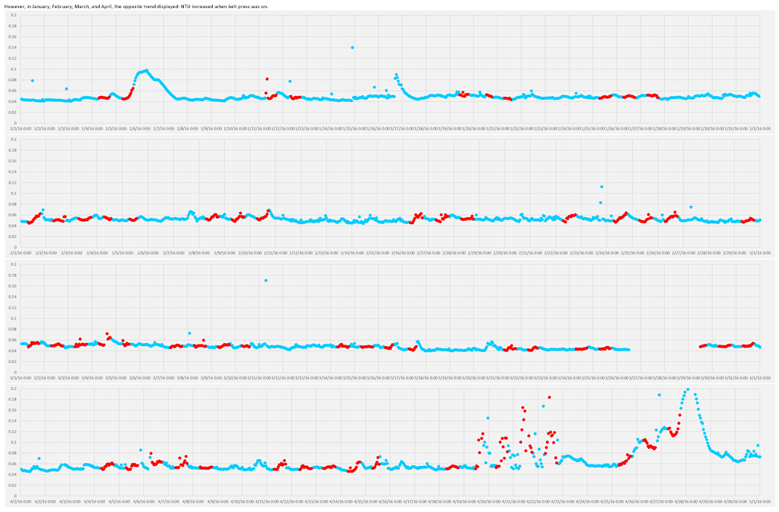
About
Learning objectives
Field work
Office work
Thank you
PWTP finished water turbidity spikes

Slide 20
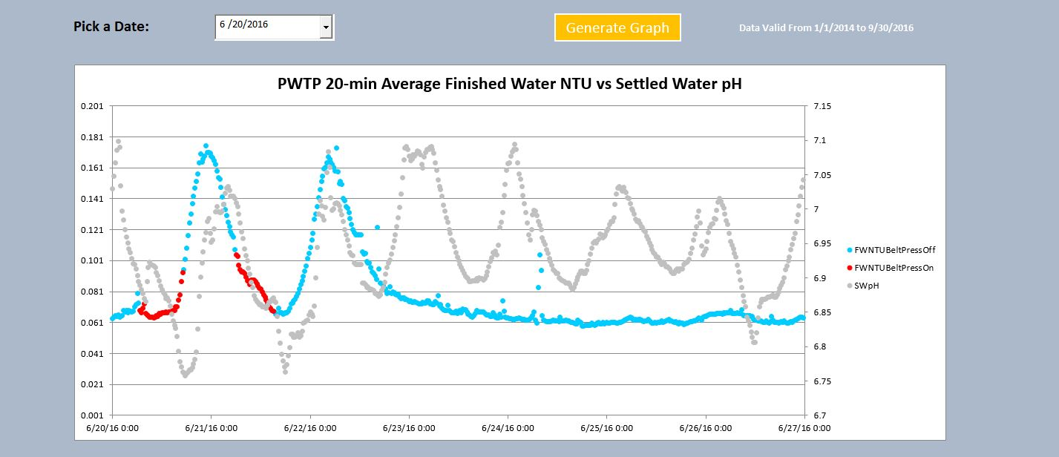
About
Learning objectives
Field work
Office work
Thank you
PWTP finished water turbidity spikes

Slide 21
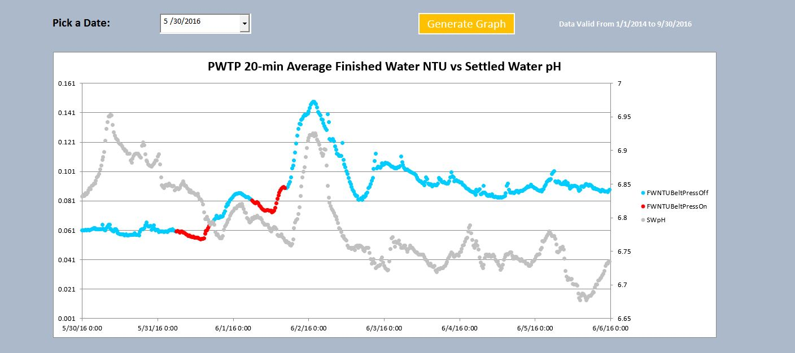
About
Learning objectives
Field work
Office work
Thank you
PWTP finished water turbidity spikes

Slide 22
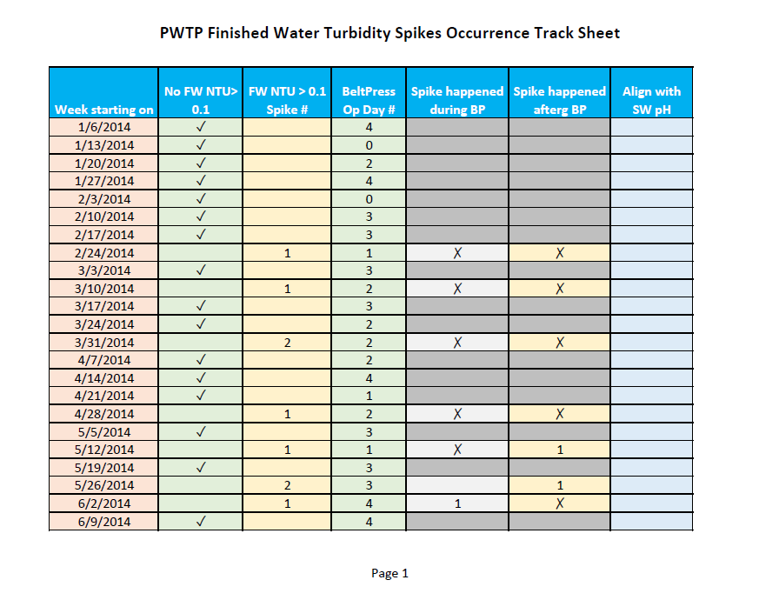
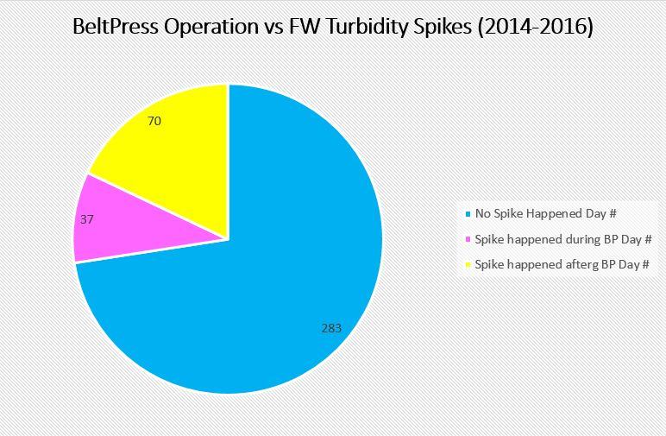
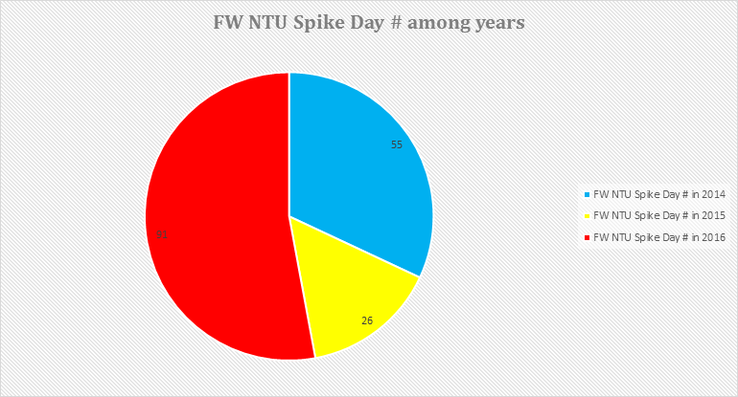
About
Learning objectives
Field work
Office work
Thank you
PWTP finished water turbidity spikes

Slide 23
About
Learning objectives
Field work
Office work
Thank you
PWTP finished water turbidity spikes
Research
observation
Background
literature
LIMS
ODMS
Result
Data analysis
Excel
Data Visualization

Slide 24
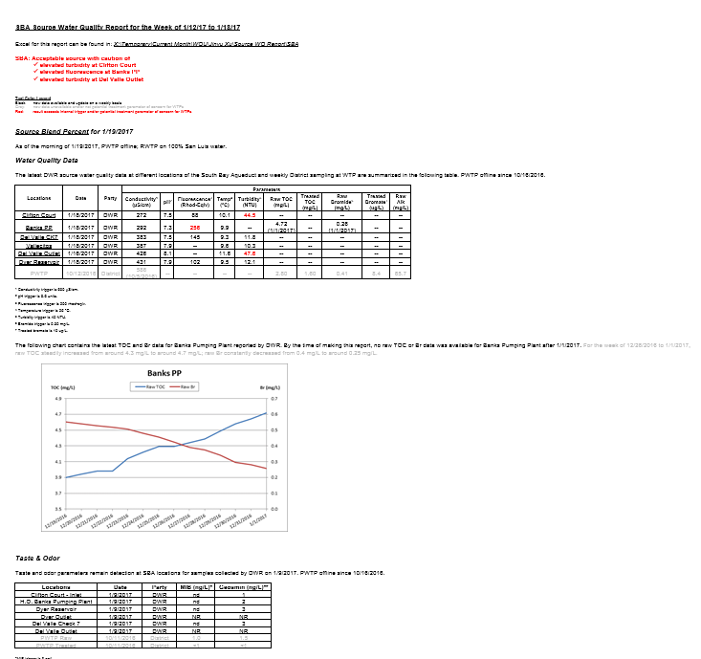
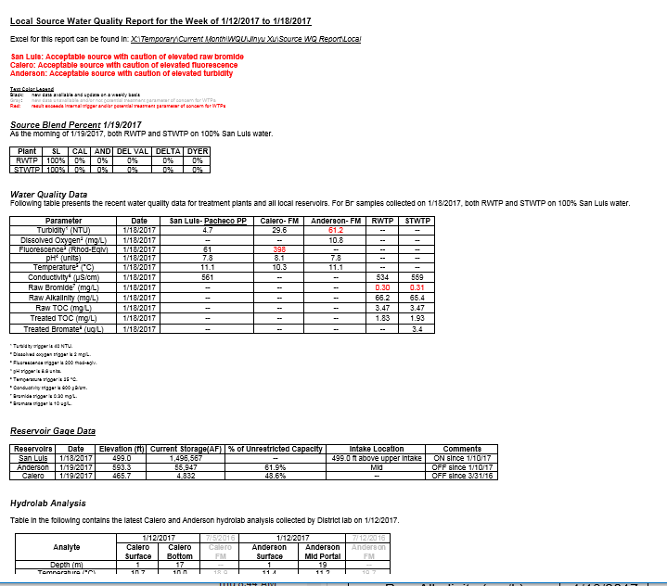
About
Learning objectives
Field work
Office work
Thank you
Source water quality reports

Slide 25
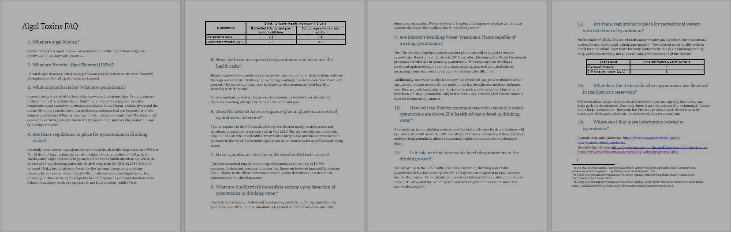
About
Learning objectives
Field work
Office work
Thank you
Algal toxin faq

Slide 26
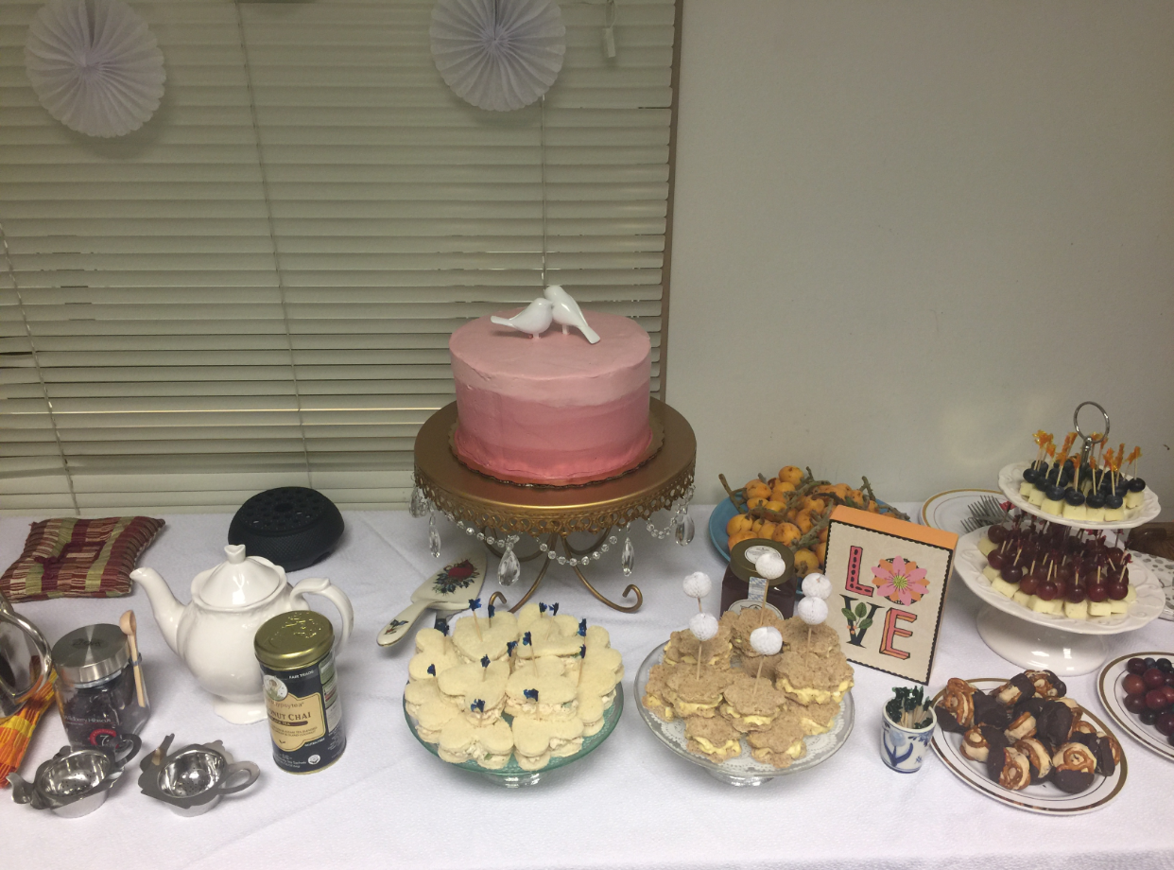
Work URL
Facebook URL
Work Email
LinkedIn URL
Work Phone
Twitter URL
Thank you
Thank you

Slide 27
company name
about
Learning objectives
Field work
Office work
Thank you

